Slide 1
Chapter Two
Requirements Engineering Processes

Slide 2
Processes
A process is an organized set of activities which transforms inputs to outputs.
Process descriptions encapsulate knowledge and allow it to be reused.
Examples of process descriptions
Instruction manual for a dishwasher
Cookery book
Procedures manual for a bank
Quality manual for software development

Slide 3
Design processes
Processes which involve creativity, interactions between a wide range of different people, engineering judgement and background knowledge and experience.
Examples of design processes
Writing a book
Organizing a conference
Designing a processor chip
Requirements engineering

Slide 4
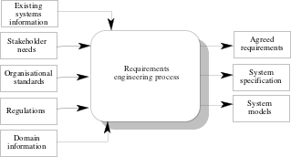
RE process - inputs and outputs

Slide 5
Input/Output description
Input or output | Type | Description
Existing system information | Input | Information about the functionality of systems to be replaced or other systems which interact with the system being specified
Stakeholder needs | Input | Descriptions of what system stakeholders need from the system to support their work
Organisational standards | Input | Standards used in an organisation regarding system development practice, quality management, etc.
Regulations | Input | External regulations such as health and safety regulations which apply to the system.

Slide 6
Cont’d…
Input or output | Type | Description
Domain information | Input | General information about the application domain of the system.
Agreed requirements | Output | A description of the system requirements which is understandable by stakeholders and which has been agreed by them.
System specification | Output | This is a more detailed specification of the system functionality which may be produced in some cases.
System models | Output | A set of models such as a data-flow model. an object model, a process model, etc. which describes the system from different perspectives

Slide 7
RE process variability
RE processes vary radically from one organization to another.
Factors contributing to this variability include
Technical maturity
Disciplinary involvement
Organizational culture
Application domain
There is therefore no ‘ideal’ requirements engineering process

Slide 8
Process models
A process model is a simplified description of a process presented from a particular perspective.
Types of process model include:
Coarse-grain activity models
Fine-grain activity models
Role-action models
Entity-relation models

Slide 9
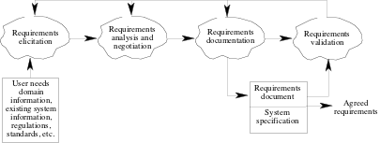
Coarse-grain activity model of RE

Slide 10
RE process activities
Requirements elicitation
Requirements discovered through consultation with stakeholders.
Requirements analysis and negotiation
Requirements are analyzed and conflicts resolved through negotiation
Requirements documentation
A requirements document is produced.
Requirements validation
The requirements document is checked for consistency and completeness.

Slide 11
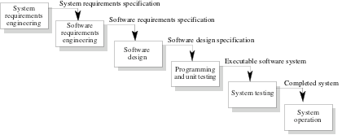
Waterfall model of the software process
Notes:
System requirements are the required specifications a device must have in order to use certain hardware or software. System Requirements
Operating system.
Minimum CPU or processor speed.
Minimum GPU or video memory.
Minimum system memory (RAM)
Minimum free storage space.
Audio hardware (sound card, speakers, etc)

Slide 12
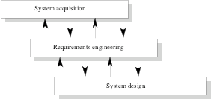
Context of the RE process

Slide 13
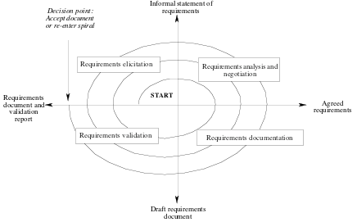
Spiral model of the RE process

Slide 14
Actors in the RE process
Actors in a process are the people involved in the execution of that process.
Actors are normally identified by their roles rather than individually.
Requirements engineering involves actors who are primarily interested in the problem to be solved (end-users, etc.) as well actors interested in the solution (system designers, etc.)
Role-action diagrams document which actors are involved in different activities.

Slide 15
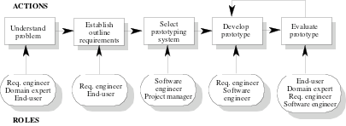
RAD for software prototyping
Notes:
RAD stands for Role Action Diagrams

Slide 16
Role descriptions
Role | Description
Domain Expert | Responsible for providing information about the application domain and the specific problem in that domain which is to be solved.
System end-user | Responsible for using the system after delivery.
Requirements Engineer | Responsible for eliciting and specifying the system requirements.
Software Engineer | Responsible for developing the prototype software system.
Project Manager | Responsible for planning and estimating the prototyping project.

Slide 17
Human and social factors
Requirements engineering processes are dominated by human, social and organizational factors because they always involve a range of stakeholders from different backgrounds and with different individual and organizational goals.
System stakeholders may come from a range of technical and non-technical background and from different disciplines.

Slide 18
Types of stakeholder
Software engineers responsible for system development.
System end-users who will use the system after it has been delivered.
Managers of system end-users who are responsible for their work.
External regulators who check that the system meets its legal requirements.
Domain experts who give essential background information about the system application domain.

Slide 19
Factors influencing requirements
Personality and status of stakeholders
The personal goals of individuals within an organization
The degree of political influence of stakeholders within an organization.

Slide 20
Process support
CASE tools provide automated support for software engineering processes.
The most mature CASE tools support well-understood activities such as programming and testing and the use of structured methods.
Support for requirements engineering is still limited because of the informality and the variability of the process.

Slide 21
CASE tools for RE
Modelling and validation tools support the development of system models which can be used to specify the system and the checking of these models for completeness and consistency.
Management tools help manage a database of requirements and support the management of changes to these requirements.
Notes:
CASE (Computer-aided Software Engineering)
CASE tool is a software package that provides support for the design and implementation of information systems.
It can document a database design and provide invaluable help in maintaining the consistency of a design.

Slide 22
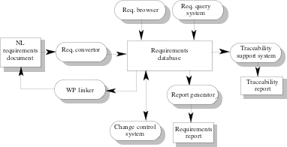
A requirements management system
Notes:
WP: stands for word processor
Top 10 requirement gathering tools
Visure.
ReqSuite. ...
Pearls. ...
Perforce Helix RM. ...
Caliber. ...
Accompa. ...
codeBeamer ALM. CodeBeamer ALM is easy-to-use and incorporates API integrations. ...
Jama Software. Jama Software provides a platform that works well with software development and testing. ...

Slide 23
Requirements management tools
Requirements browser
Requirements query system
Traceability support system
Report generator
Requirements converter and word processor linker
Change control system

Slide 24
Process improvement
Process improvement is concerned with modifying processes in order to meet some improvement objectives.
Improvement objectives
Quality improvement
Schedule reduction
Resource reduction
Notes:
Process improvement is sometimes seen simply as the introduction of new
methods or techniques. Because these are more advanced technically than existing methods, you might think that
these will necessarily lead to process improvements. A good example of this was the widespread investment in
CASE technology in the late 1980s and early 1990s. Many
organisations bought CASE tools then found that they had
no significant effect on the productivity or quality of their
products. The CASE tools changed the process but did
not address the real problems faced by these organisations.
In many cases, these were problems with the
system requirements.

Slide 25
Planning process improvement
What are the problems with current processes?
What are the improvement goals?
How can process improvement be introduced to achieve these goals?
How should process improvements be controlled and managed?

Slide 26
RE process problems
Lack of stakeholder involvement
Business needs not considered
Lack of requirements management
Lack of defined responsibilities
Stakeholder communication problems
Over-long schedules and poor quality requirements documents

Slide 27
Process maturity
Process maturity can be thought of as the extent that an organization has defined its processes, actively controls these processes and provides systematic human and computer-based support for them.
The SEI’s Capability Maturity Model is a framework for assessing software process maturity in development organizations
Notes:
Process maturity is an indication of how close a developing process is to being complete and
capable of continual improvement through qualitative measures and feedback.
Thus, for a process to be mature, it has to be complete in its usefulness, automated, reliable in information and continuously improving.

Slide 28
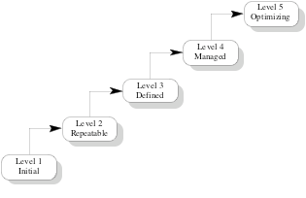
Capability maturity model
Notes:
The basis idea underlying the CMM approach is that
organizations should assess their maturity then introduce
process changes which will enable them to progress up
the maturity 'ladder' in a five stage process.

Slide 29
Maturity levels
Initial level
Organizations have an undisciplined process and it is left to individuals how to manage the process and which development techniques to use.
Repeatable level
Organizations have basic cost and schedule management procedures in place. They are likely to be able to make consistent budget and schedule predictions for projects in the same application area.
Defined level
The software process for both management and engineering activities is documented, standardized and integrated into a standard software process for the organization.

Slide 30
Cont’d…
Managed level
Detailed measurements of both process and product quality are collected and used to control the process.
Optimizing level
The organization has a continuous process improvement strategy, based on objective measurements, in place.

Slide 31
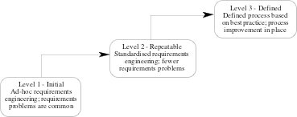
RE process maturity model

Slide 32
RE process maturity levels
Initial level
No defined RE process.
Suffer from requirements problems such as requirements volatility, unsatisfied stakeholders and high rework costs.
Dependent on individual skills and experience.
Repeatable level
Defined standards for requirements documents and policies and procedures for requirements management.
Defined level
Defined RE process based on good practices and techniques.
Active process improvement process in place.
Notes:
Requirements volatility refers to additions, deletions and modifications of requirements during the system development life cycle,
RV creates additional work in design and coding, which increases the system development cost and time and

Slide 33
Good practice for RE process improvement
RE processes can be improved by the systematic introduction of good requirements engineering practice.
Each improvement cycle identifies good practice guidelines and works to introduce them in an organization.

Slide 34
Examples of good practice guidelines
Define a standard document structure
Uniquely identify each requirement
Define policies for requirements management
Use checklists for requirements analysis
Use scenarios to elicit requirements
Specify requirements quantitatively
Use prototyping to animate requirements
Reuse requirements

Slide 35
Key points
The requirements engineering process is a structured set of activities which lead to the production of a requirements document.
Inputs to the requirements engineering process are information about existing systems, stakeholder needs, organizational standards, regulations and domain information.
Requirements engineering processes vary radically from one organization to another. Most processes include requirements elicitation, requirements analysis and negotiation and requirements validation.

Slide 36
Cont’d…
Requirements engineering process models are simplified process description which are presented from a particular perspective.
Human, social and organizational factors are important influences on requirements engineering processes.
Requirements engineering process improvement is difficult and is best tackled in an incremental way.
Requirements engineering processes can be classified according to their degree of maturity.

Slide 37
Thank You!
?

